Slide 1
UN SDGs and Ranking
September 2024
Dr Abdul Wahid Usmani
Director
Quality Management & Accreditation
Jinnah Sindh Medical University, Karachi.

Slide 2
Session Objectives
By the end of the workshop, participants will be able to:
Comprehend the framework of SDGs.
Comprehend the standards and requirements of Impact Ranking.
Identify the SDGs where a university may be contributing.
Fill the set of requirements in a specific SDG for Impact Ranking.

Slide 3
What are Sustainable Developmental Goals (SDGs)
The Sustainable Development Goals (SDGs) were adopted by the United Nations in 2015 as a universal call to action to end poverty, protect the planet, and ensure that by 2030 all people enjoy peace and prosperity. There are17 SDGs which are integrated—they recognize that action in one area will affect outcomes in others.

Slide 4
UN SDGs

Slide 5
SDGs and Universities
THREE KEY ROLES:
Expanding human capital with an SDG perspective: first, by training students to understand how the SDGs are going to make their work better and more sustainable.
Universities will need to educate their students on the social, economic and environmental implications of their future careers and professional work.

Slide 6
SDGs and Universities
Research. Researchers at universities have a privileged vantage point to look at the different SDGs, understand what approaches are more effective and analyze the process of implementing the 2030 Agenda.

Slide 7
SDGs and Universities
Implementing the agenda. From a role of observers, universities are increasingly becoming actors in multi-stakeholder partnerships for the SDGs. University researchers and students are participating hands-on in projects with their expertise, time and financial resources. They can contribute to knowledge transfer and build the tools that the SDGs will require.

Slide 8
Various International Rankings
Major international rankings
QS World University Rankings
Times Higher Education World University Rankings
Academic Ranking of World Universities

Slide 9
Current Scenario in Higher Education
Ranking Race
Lack of database.
Pressure from management
Projection of half truth
Focus on the part

Slide 10
What is Impact Ranking
The “THE Impact Rankings” are the only global performance tables that assess universities against the United Nations’ Sustainable Development Goals (SDGs)

Slide 11
What is Impact Ranking
They capture universities’ impact on society based on institutions’ success & progress in delivering the UN-SDGs. It can be a catalyst for action, a mechanism for holding universities to account, and an opportunity for them to highlight great work that they are already doing.

Slide 12
SDGs and Higher Education
Higher Education Institutions (HEIs) are on a unique position to be at the forefront of the Sustainable Development Goals (SDGs) promotion and serve as a benchmark for other sectors of the economy. HEIs can also contribute to the discussions on the SDGs in society at large.

Slide 13
What is Impact Ranking
Although the SDGs aren’t focused on higher education, the achievement of the SDGs require different sectors including higher education sector working together in an integrated manner by pooling financial resources, knowledge and expertise.

Slide 14
What is Impact Ranking
The rankings are open to any university that teaches at either undergraduate or postgraduate level.
Although research activities form part of the methodology, there is no minimum research requirement for participation.

Slide 15
Impact Ranking Parameters: General
Participation in the overall ranking requires universities to submit data to at least four SDGs one of which must be SDG 17 – Partnerships for the Goals.
If a university submits data, but doesn’t fulfil the requirement to be part of the overall ranking they will still be ranked in the SDGs for which they have provided data.

Slide 16
How to Understand SDGs

Slide 17
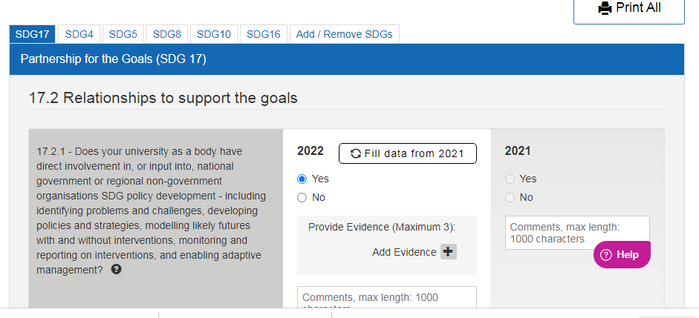

Slide 18
Partnership for the Goals (SDG 17)
17.2.2 - Does your university as a body initiate and participate in cross-sectoral dialogue about the SDGs, e.g. conferences involving government/NGOs?
17.2.3 - Does your university as a body participate in international collaboration on gathering or measuring data for the SDGs?

Slide 19
Partnership for the Goals (SDG 17)
17.2.4 - Does your university as a body, through international collaboration and research, review comparative approaches and develop international best practice on tackling the SDGs?
17.2.5 - Does your university as a body collaborate with NGOs to tackle the SDGs through:

Slide 20
17.3 Publication of SDG reports
17.3.1 - Please indicate if your university publishes progress against SDG1
17.3.2 - Please indicate if your university publishes progress against SDG2
17.3.3 - Please indicate if your university publishes progress against SDG3
17.3.4 - Please indicate if your university publishes progress against SDG4

Slide 21
17.4 Education for the SDGs
17.4.1 - Does your university as a body have a commitment to meaningful education around the SDGs across the university, that is relevant and applicable to all students?
17.4.2 - Does your university as a body have dedicated courses (full degrees, or electives) that address sustainability and the SDGs?
17.4.3 - Does your university as body have dedicated outreach educational activities for the wider community, which could include alumni, local residents, displaced people?

Slide 22
SDG | Numbers
4 | Number of graduates
 | 4.2.2 - Number of graduates who gained a qualification that entitled them to teach at primary school level
 | 4.4.1 - Number of students
 | 4.4.2 - Number of students starting a degree
 | 4.4.2 - Number of first-generation students starting a degree

Slide 23
4.3.1 - Does your university as a body provide access to educational resources for those not studying at the university, e.g. computers, library, online courses, access to lectures, etc?
4.3.2 - Does your university as a body host events at university that are open to the general public: public lectures, community educational events?
4.3.4 - Does your university as a body undertake educational outreach activities (e.g. tailored lectures or demonstrations) beyond campus, e.g. in local schools, in the community, including voluntary student-run schemes?

Slide 24
How to Collect Data

Slide 25
SDG | Numbers | Questions | Policy
4 | Number of graduates | 4.3.1 - Does your university as a body provide access to educational resources for those not studying at the university, e.g. computers, library, online courses, access to lectures, etc? | 4.3.5 - Does your university as a body have a policy that ensures that access to these activities is accessible to all, regardless of ethnicity, religion, disability?
 | 4.2.2 - Number of graduates who gained a qualification that entitled them to teach at primary school level | 4.3.2 - Does your university as a body host events at university that are open to the general public: public lectures, community educational events?

Slide 26
Policy Title | When Created | Who would provide
5.6.1 - Does your university as a body have a policy of non-discrimination against women? | Developed in 2010 | Registrar Office
5.6.2 - Does your university as a body have a policy of non-discrimination for transgender people?

Slide 27
Required Numbers | Answer | Responsible Body
5.4.2 - Number of academic staff | 565 | Registrar Office
5.5.1 - Number of graduates: Total | 1500 | Students Affairs

Slide 28
Times Impact Rankings 2022
Good Health and Wellbeing (SDG 3)
Question | Your Answer | Provide Evidence | Who can provide?
3.3.1 Does your university as a body have current collaborations with local or global health institutions to improve health & wellbeing outcomes? Yes No local collaborations national collaborations global collaborations |  | Have current collaborations with local, national, or global health institutions to improve health and Well-being outcomes. | Heads to decide

Slide 29
How Score is Calculated

Slide 30
Impact Ranking Calculations
The overall score is generated from the score for SDG 17 (worth up to 22% of the overall score), plus the three strongest of the other SDGs for which they provided data (each worth up to 26% of the overall score).
The scores for each SDG are based on a series of metrics. Each metric is themed and may be composed of individual indicators.

Slide 31
Impact Ranking Calculations
Evidence is assessed according to a simple calculation approach. Where a metric requires evidence a series of questions are asked, and points are assigned according to the answer.

Slide 32
Impact Ranking Calculations
Where evidence is provided, THE evaluate if the evidence fully answers the question, partially answers the question, or does not answer the question. This scores one, half, or zero points. Universities that are unable to provide data on a specific metric are scored at zero for that metric.
Evidence is evaluated for relevance:
1 point specific
0.5 point general
0 point not relevant

Slide 33
Calculating the overall score
Calculation of the overall score is done using the following proportions:
SDG 17: 22%
Top three SDGs: each 26%

Slide 34
Conclusion
Ranking is inevitable whether we like it or not.
Impact Ranking connects our good practices with global community
Provision of Data is the essence of this ranking.
Try linking your practices with SDGs from now on.
Participate this year and learn how to make it more effective for future.

Slide 35
Question/Answer

